Slide 1

NIK MOLNAR
@nikmd23
@nikmd23
VISUAL STUDIO ONLINE
A look at the future of developer productivity and collaboration
Notes:
SETUP:
USING EDGE
Open github..com/nikmd23/ballpark-tracker
Create ballpark-tracker, Premium, Never suspend, w/ dotfiles
Open VS Code
---
Intro & Journey – 5
Demo #1 (VSC Intro) – 10
Demo #2 (IC) – 5
Review – 2
Demo #3 (VSO Web) –10
Demo #4 (Nexus) – 5
Demo #5 (Self-Hosted) - 5

Slide 2
NIK MOLNAR
@nikmd23
@nikmd23
MAKE THE CLOUD YOUR DEV BOX: VISUAL STUDIO ONLINE
Notes:
SETUP:
USING EDGE
Open github..com/nikmd23/ballpark-tracker
Create ballpark-tracker, Premium, Never suspend, w/ dotfiles
Open VS Code
---
Intro & Journey – 5
Demo #1 (VSC Intro) – 10
Demo #2 (IC) – 5
Review – 2
Demo #3 (VSO Web) –10
Demo #4 (Nexus) – 5
Demo #5 (Self-Hosted) - 5

Slide 3

Trends
Microservices
Open & Inner Source
Distributed Teams
Time to Market
Notes:
These trends include:
- The explosion of cloud native development and microservices have enabled developers to use multiple languages and stacks in a single system to take advantage of each technology’s particular strengths.
- Open source and inner source are making collaboration more important than ever. As a result, developers are working across boundaries in many codebases, often at the same time.
- More and more teams are distributed remotely, or leveraging freelancers, which magnify the pain of onboarding new team members without the benefit of a local IT presence.
- Developers facing expectations for decreased time-to-market are seeking techniques and technologies to help them collaborate more quickly and increase productivity.

Slide 4
What Is A Dev Environment?
Notes:
Let’s start with context. Having the right context and right setup we’ve learned is key.

Slide 5

What Is A Dev Environment?
Editor

Slide 6

What Is A Dev Environment?
Editor
Source

Slide 7

What Is A Dev Environment?
Editor
Source
Runtimes

Slide 8

What Is A Dev Environment?
Editor
Debugger
Source
Runtimes

Slide 9

What Is A Dev Environment?
Editor
Debugger
Source
Runtimes
Packages

Slide 10

What Is A Dev Environment?
Editor
Debugger
Tools
Source
Runtimes
Packages

Slide 11

What Is A Dev Environment?
Terminal
Editor
Debugger
Tools
Source
Runtimes
Packages

Slide 12

What Is A Dev Environment?
Terminal
Editor
Debugger
Tools
Source
Extensions
Runtimes
Packages

Slide 13

What Is A Dev Environment?
Terminal
Editor
Debugger
Config
Tools
Source
Extensions
Runtimes
Packages

Slide 14


What Is A Dev Environment?
You!
Terminal
Project
Editor
Debugger
Config
Tools
Source
Extensions
Runtimes
Packages

Slide 15
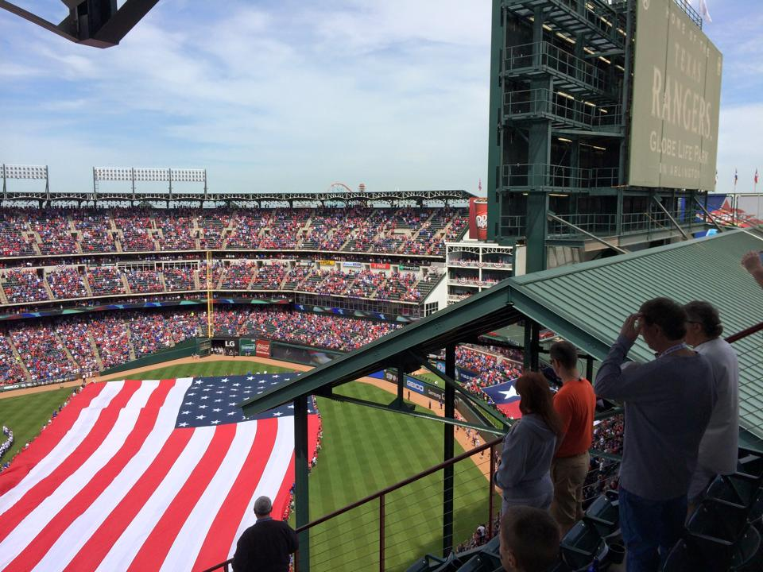





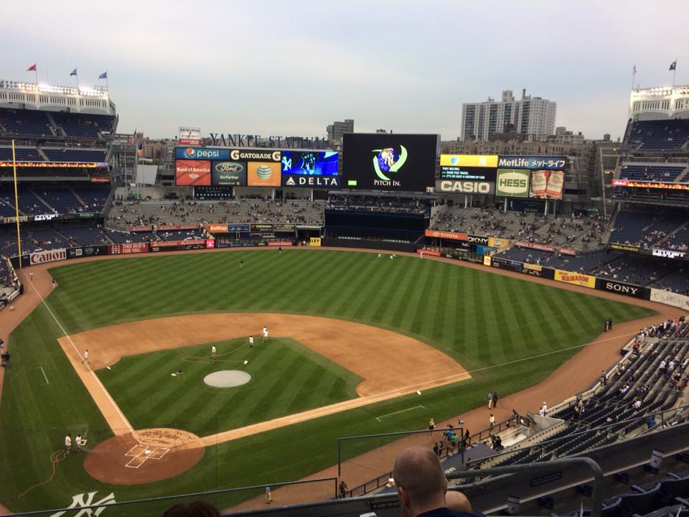









My Journey
ECO
Path To 30
Beginning in 2003, I set out to see a game at every MLB stadium, inadvertently joining the “Ballpark Chasers” club. Through the course of many summers spent across all corners of our great country (and Canada!), I’ve been to games with countless friends, caught four foul balls, grew my family by one, ate more nachos than any human should, and loved every second of it. Along the way, I’ve made various attempts to chronicle my journey, by saving ticket stubs, collecting stamps in a baseball “passport”, and finally with a custom-built app.

Slide 16



Slide 17


30 For 30 Triumph!

Slide 18









Review
Customized for your Project
VS Online Environment
1
Source
5
Terminal
2
Debugger
6
Runtimes
3
Packages
7
Tools
4
Extensions
8
Config
Personalized for you

Slide 19
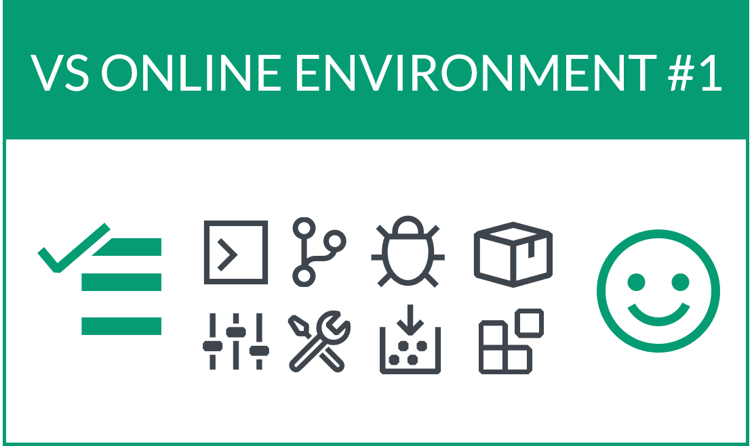

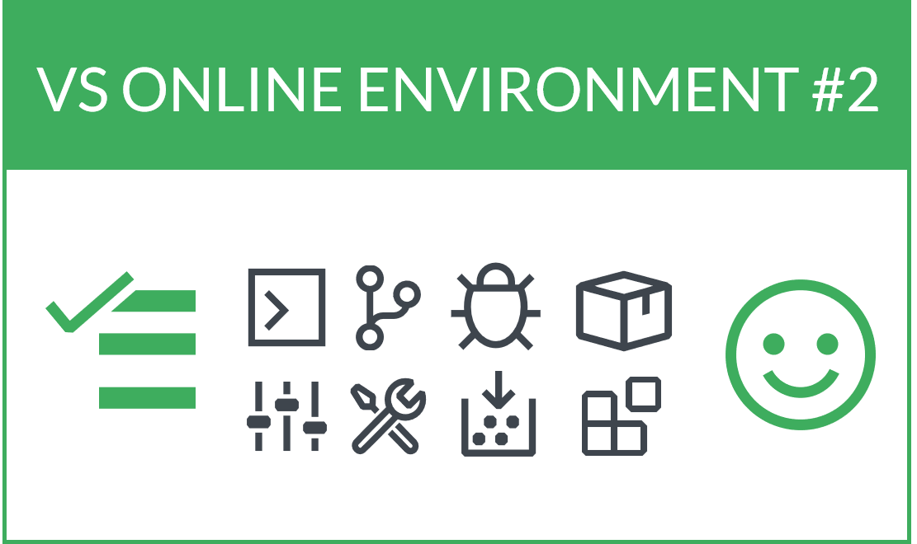
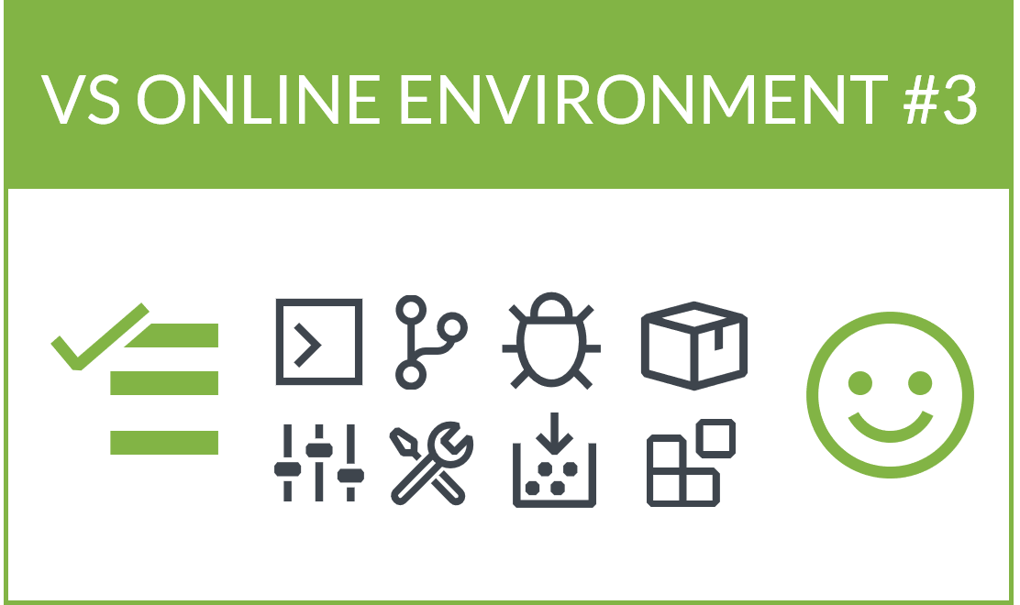

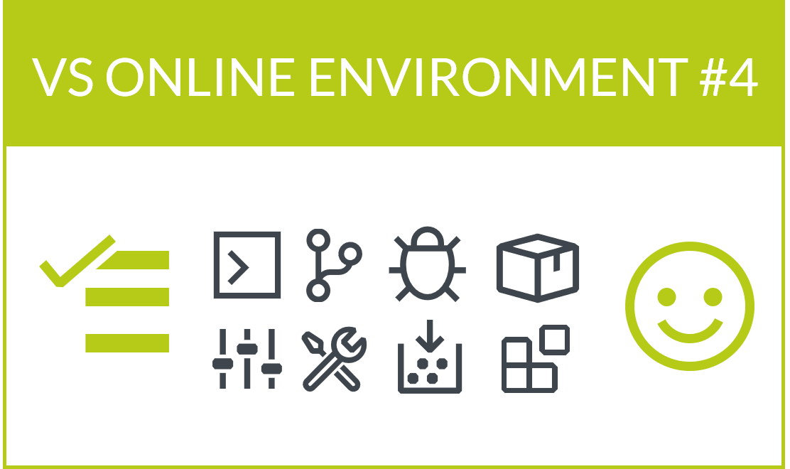



Visual Studio Online
Azure-Hosted
Editors
Compute
Network
Storage

Slide 20



Visual Studio Online
Azure-Hosted
Editors
Compute
Network
Storage

Slide 21


Next Challenge - AAA
pacific Coast League
international League

Slide 22
Visual Studio Online
Azure-Hosted
Editors
Compute
Network
Storage

Slide 23
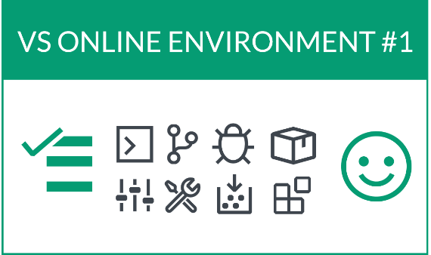

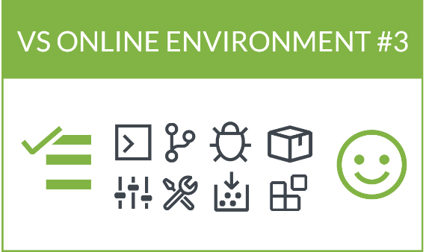
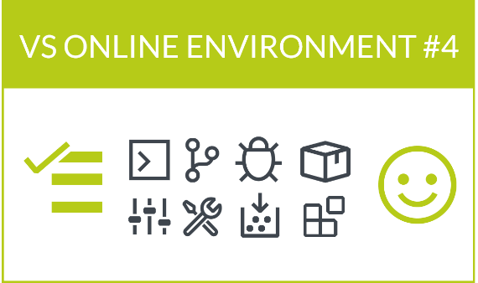
Visual Studio Online
Instance Types
Azure-Hosted
Editors
Standard
46
¢
Cores: 4 Ram: 8 gb Disk: 64 GB SSD
Compute
Premium
Network
88
cores: 8 RAM: 16 Gb Disk: 64 GB SSD
¢
Storage

Slide 24



Visual Studio Online
Azure-Hosted
Editors
Self-Hosted
Free!
Compute
Network
Storage

Slide 25



Summary + Questions
Public preview
Contact
Visual studio Online
Nik Molnar
@nikmd23 || microsoftDocs/vsonline
@nikmd23 || #vsonline
Private preview
General Availability
Learn More
Visual studio Online
Live Share & IntelliCode
https://aka.ms/vsoblog

